Slide 1
GMS Tips for entering Year-End Prevention Data and Administrative Time Deliverables

Slide 2
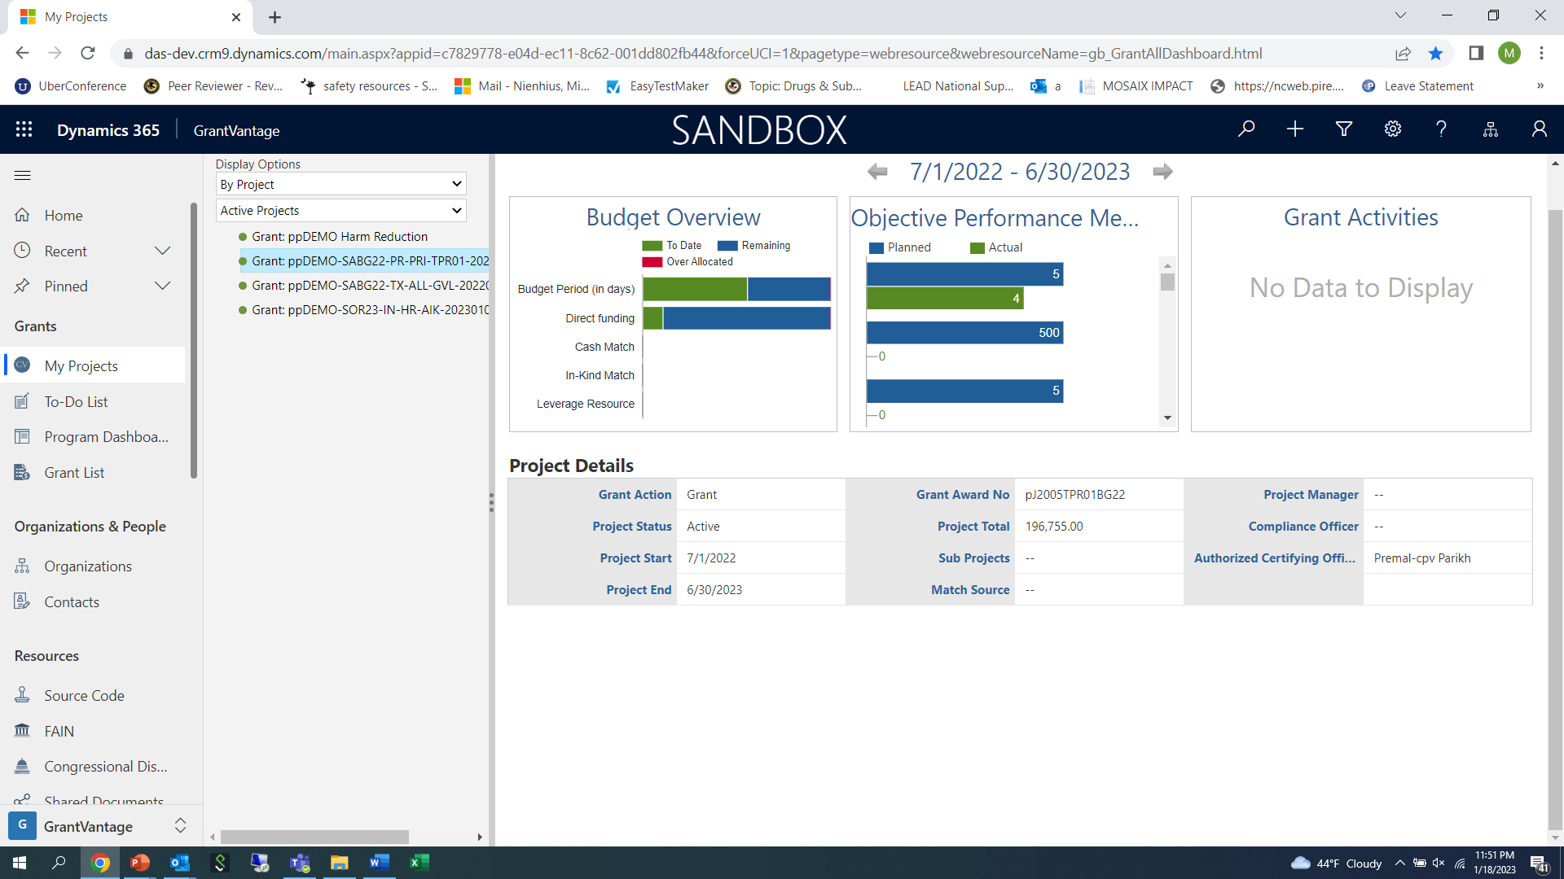
Select the Primary Prevention (PRI-PR) project from your agency’s project list

Slide 3
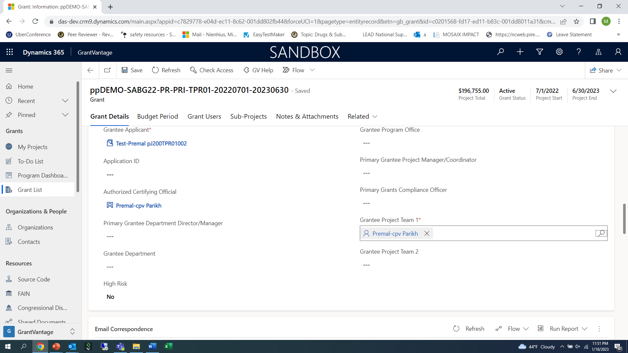
Double click on the project to bring up the screen below:

Slide 4
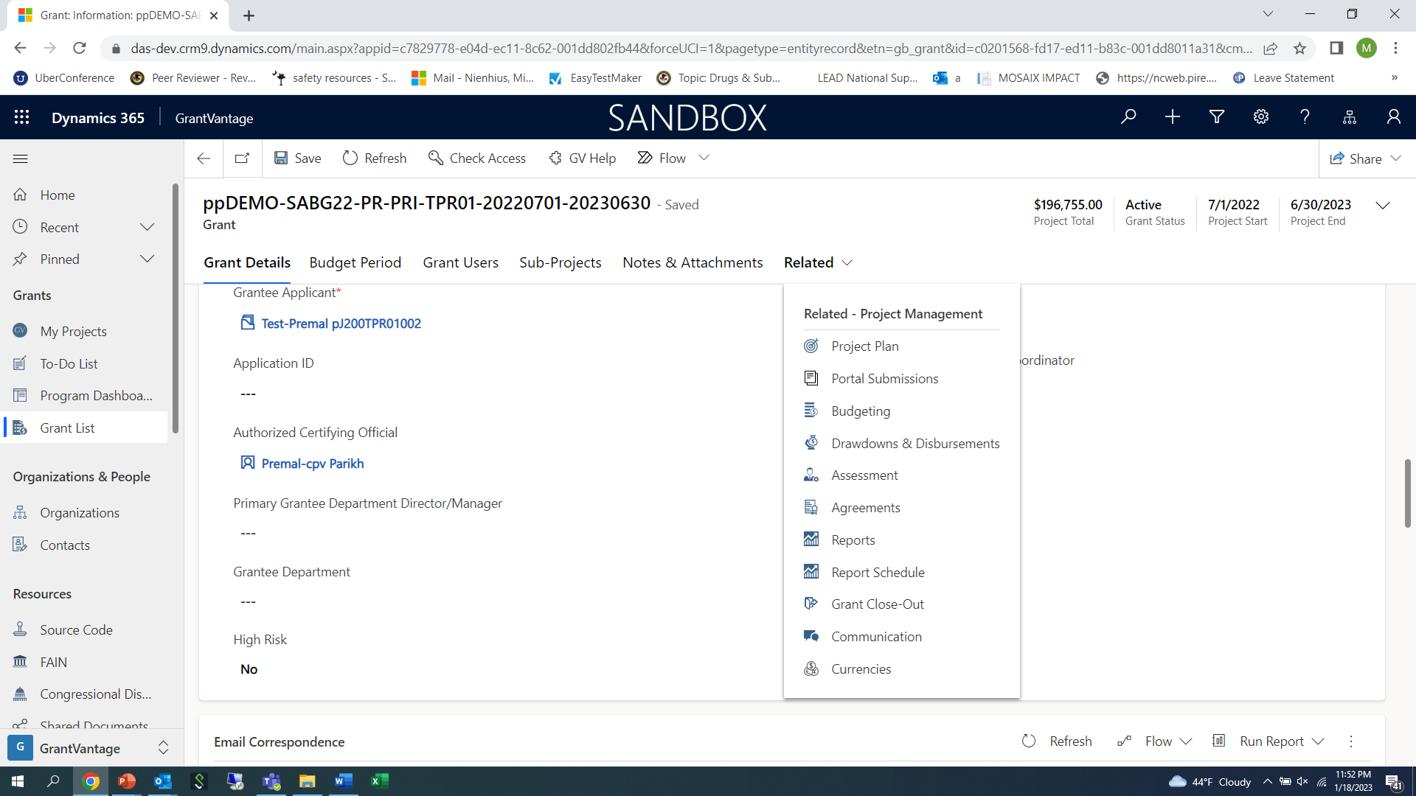
Click on “Related” tab to bring up menu as seen below

Slide 5
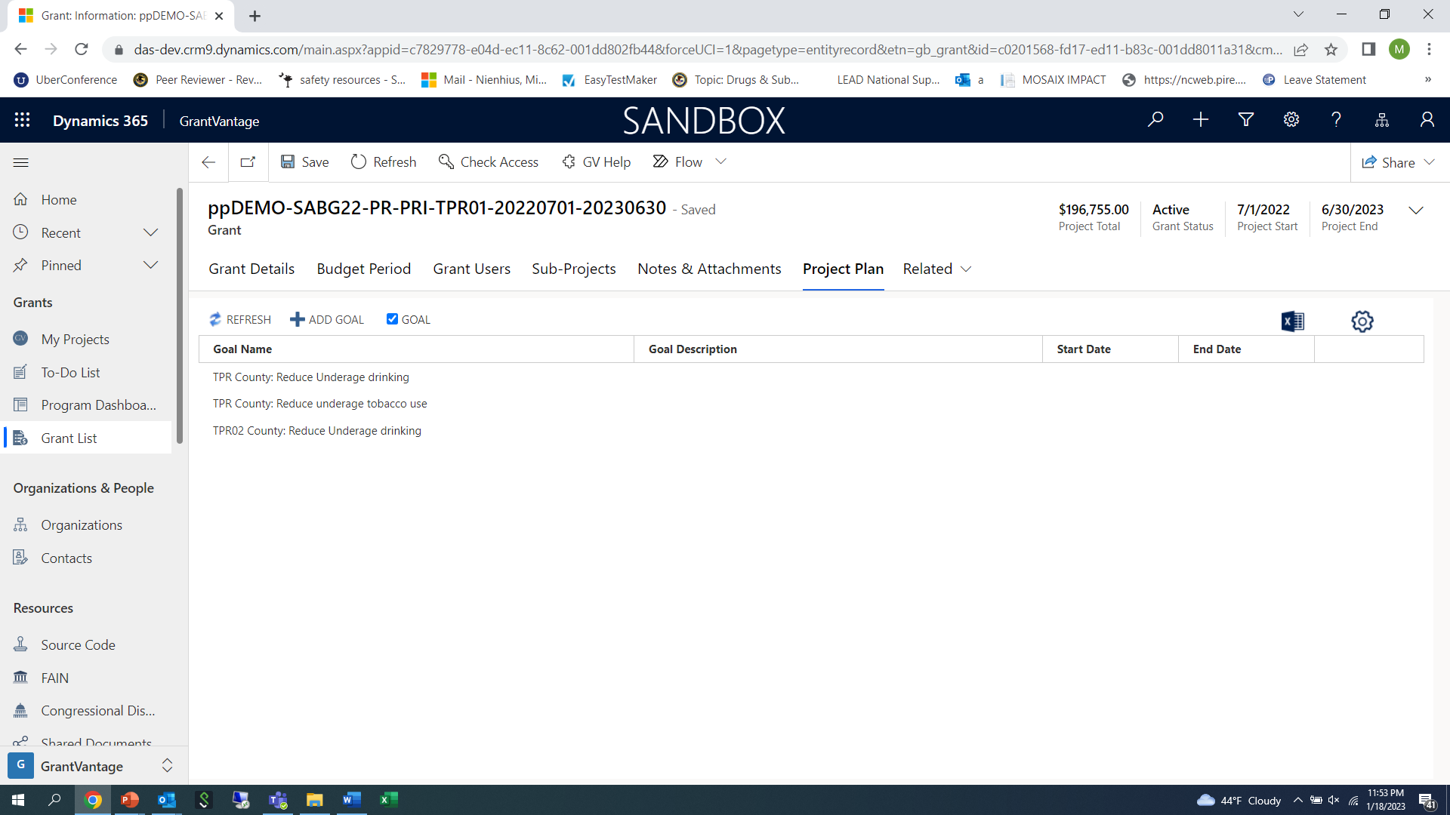
Single click on “Project Plan” to bring up your project “Goals”

Slide 6
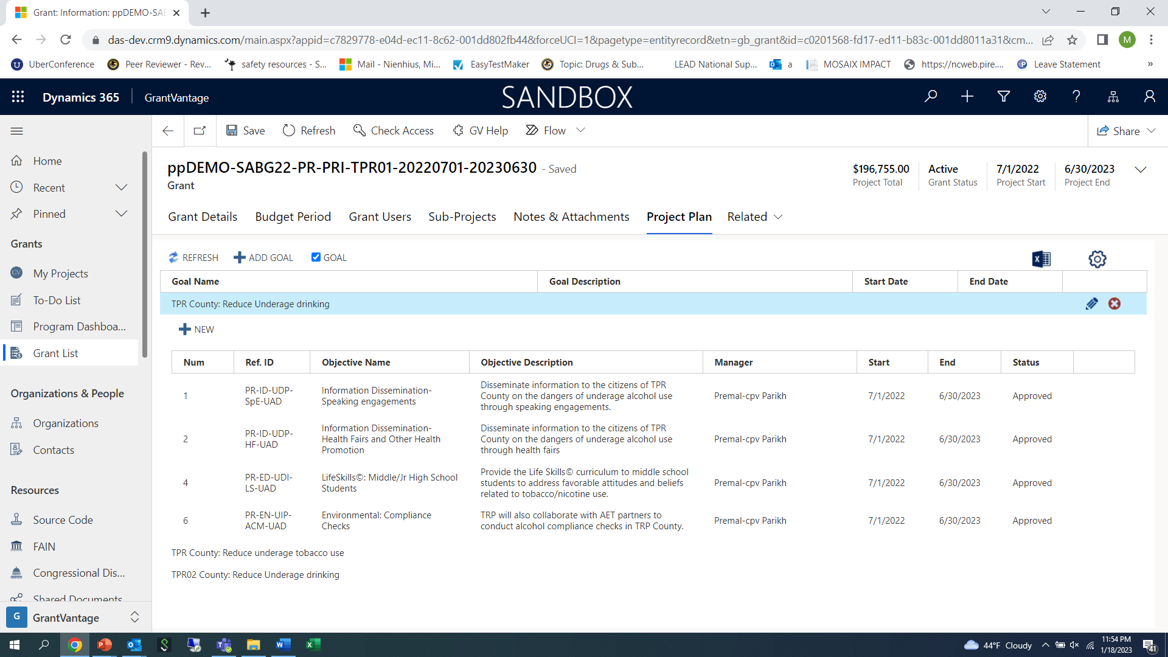
Single click on a “Goal” to bring up the “Objectives”

Slide 7
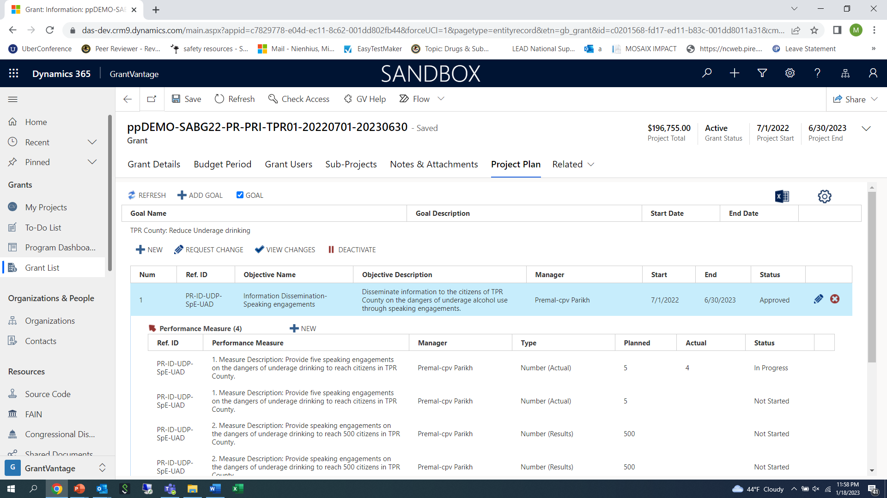
Single Click on an “Objective” to bring up the “Performance Measure” (PM) option

Slide 8
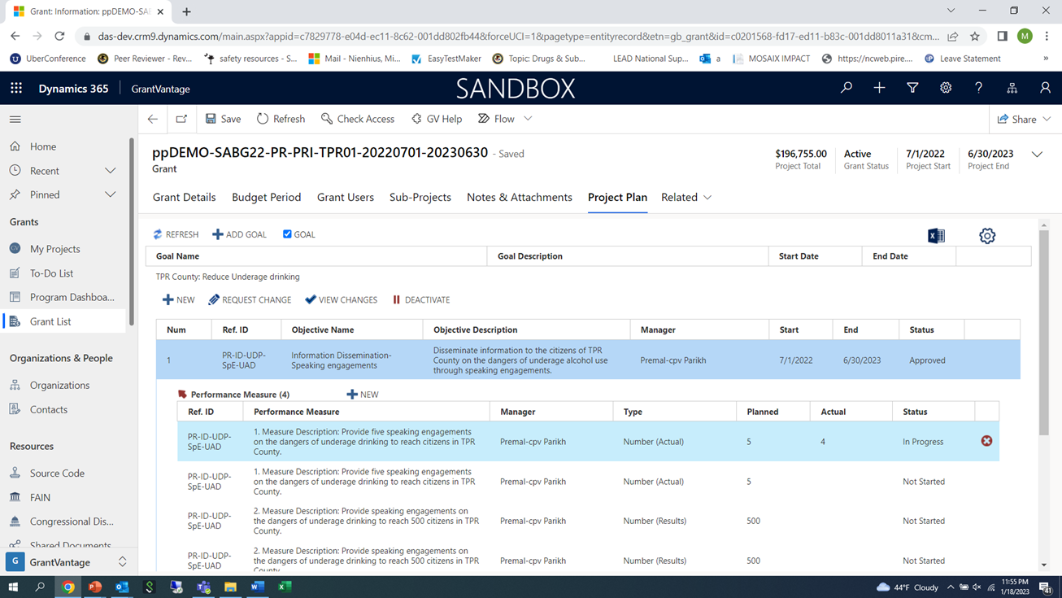
Single Click on “PM” to open up the “PM” for reporting

Slide 9
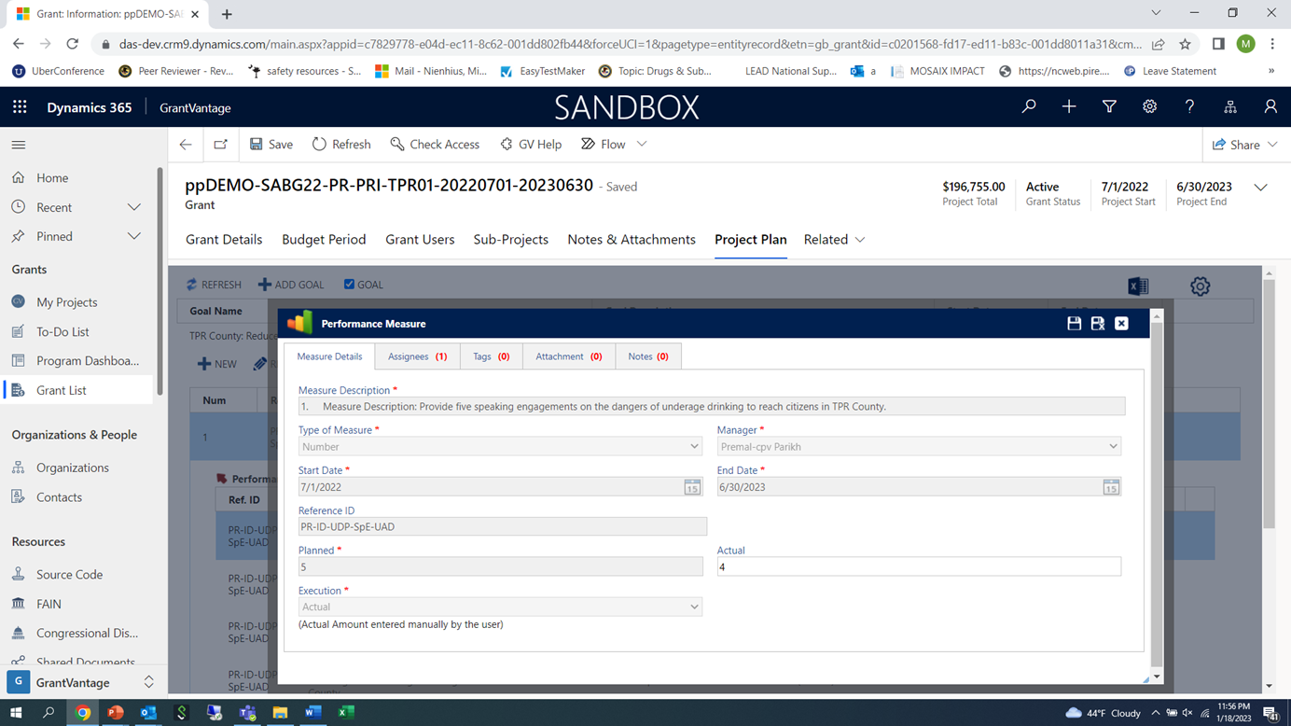
Double click on “PM” to open up the “PM” details screen for reporting

Slide 10
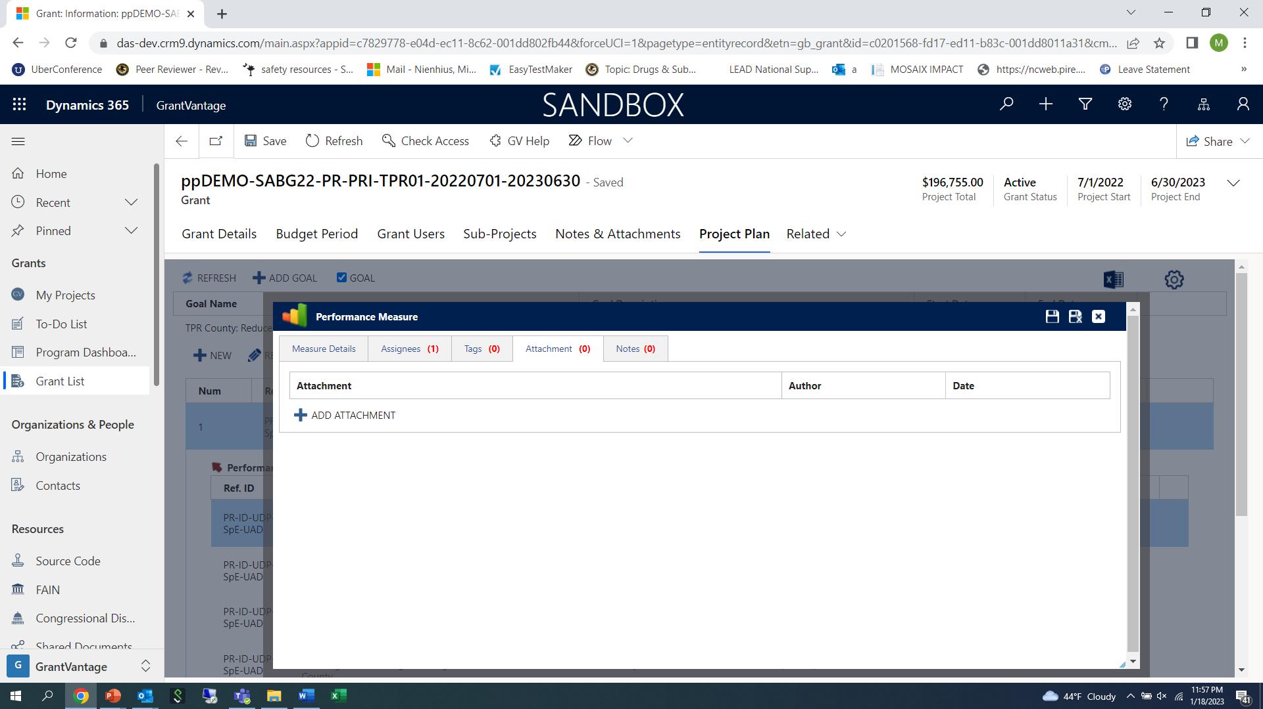
Single click on the “attachment” tab to bring up the screen to add the “Monthly Administrative Time” Excel spreadsheet file that is saved on your computer

Slide 11
Steps to attach a file to PM:
Single click on “+ADD ATTACHMENT”
Single click on “Choose File”-this will bring up a menu from your computer-find the file that you want to upload that is saved on your computer desktop or files
Make sure to label the Excel spreadsheet by the month. For example, “Administrative Time Jan 23”
Click on the file you want to attach and then click open-you should now see that file populate beside the “choose file” in the box-then click on the “disk” icon to save file.
To save the entire record, click on the “disk” at the top in the blue area to save. The “disk” with the “x” will save and close the file.
If you need to make a change to the file at anytime, you can go in and click the trashcan icon to delete the file and re-attach a new file.
Add a new file each month-you should be able to see multiple files over time.

Slide 12
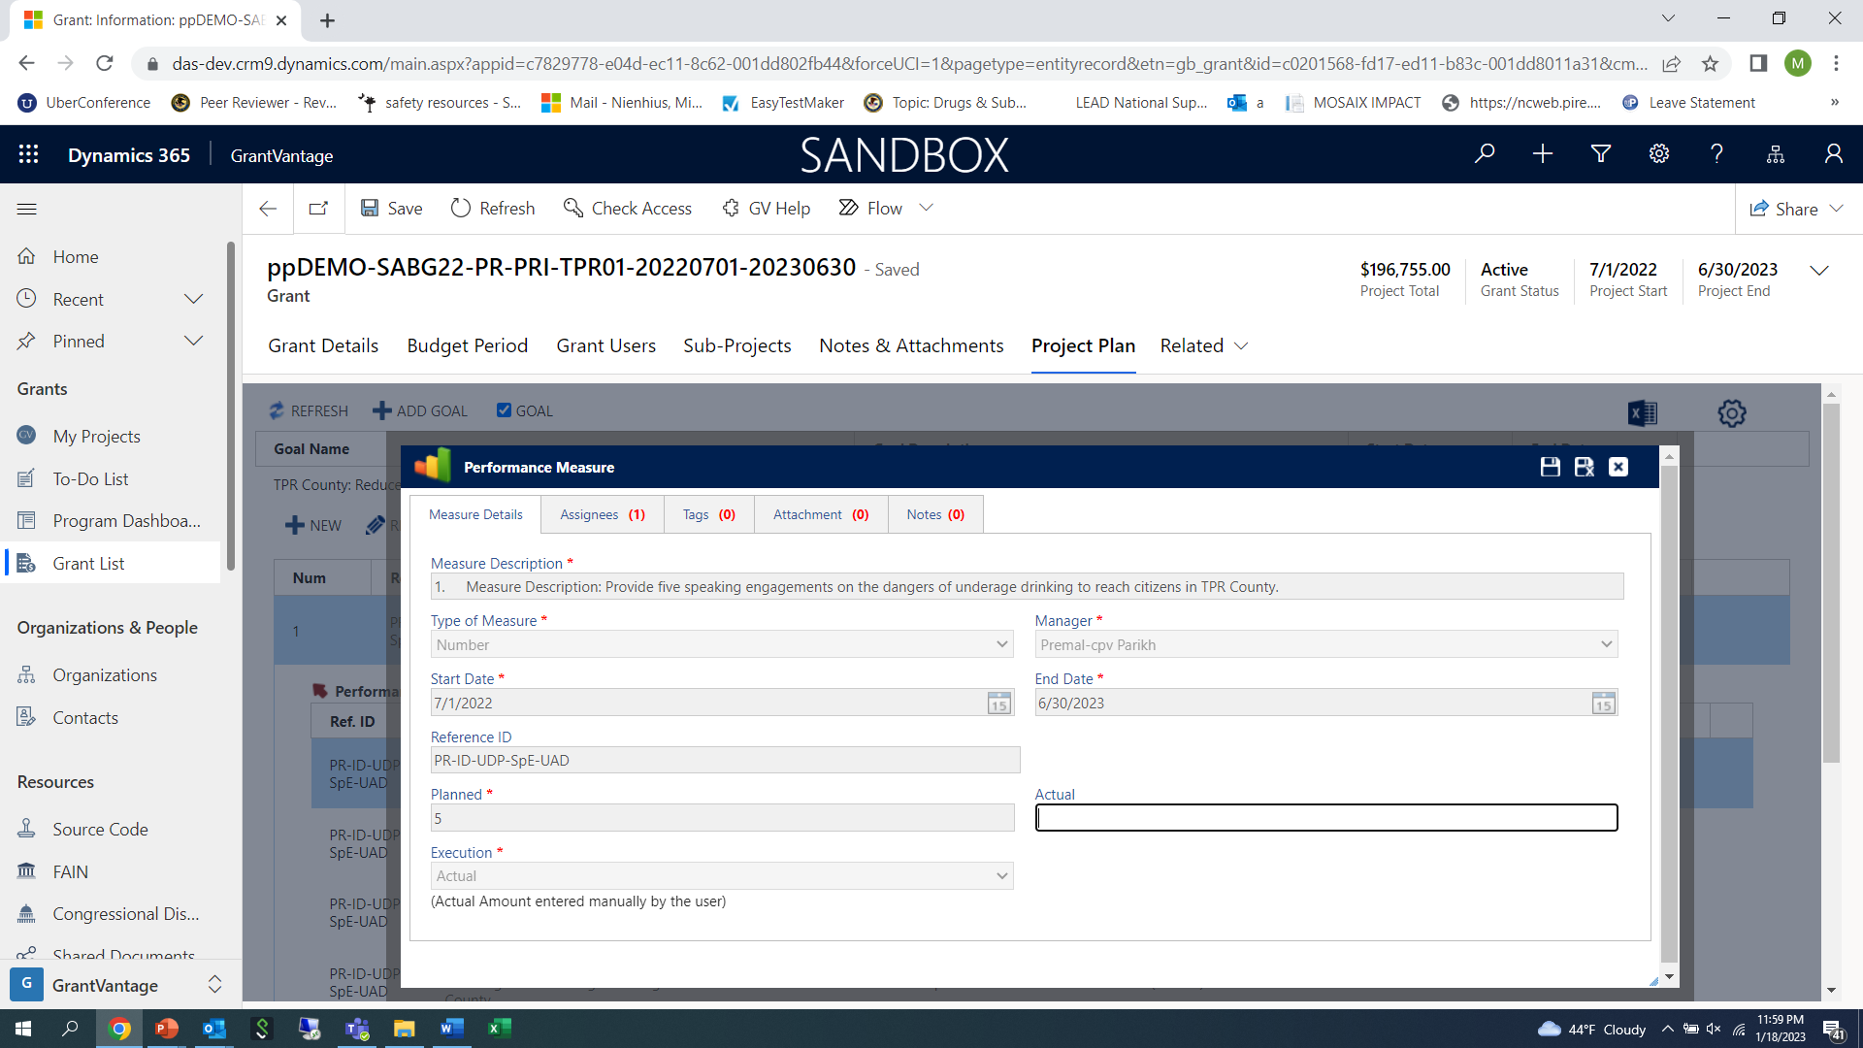
Steps to enter “Actuals” for Year-end reports
Double click on the PM to open up the reporting screen for this performance measure.

Slide 13
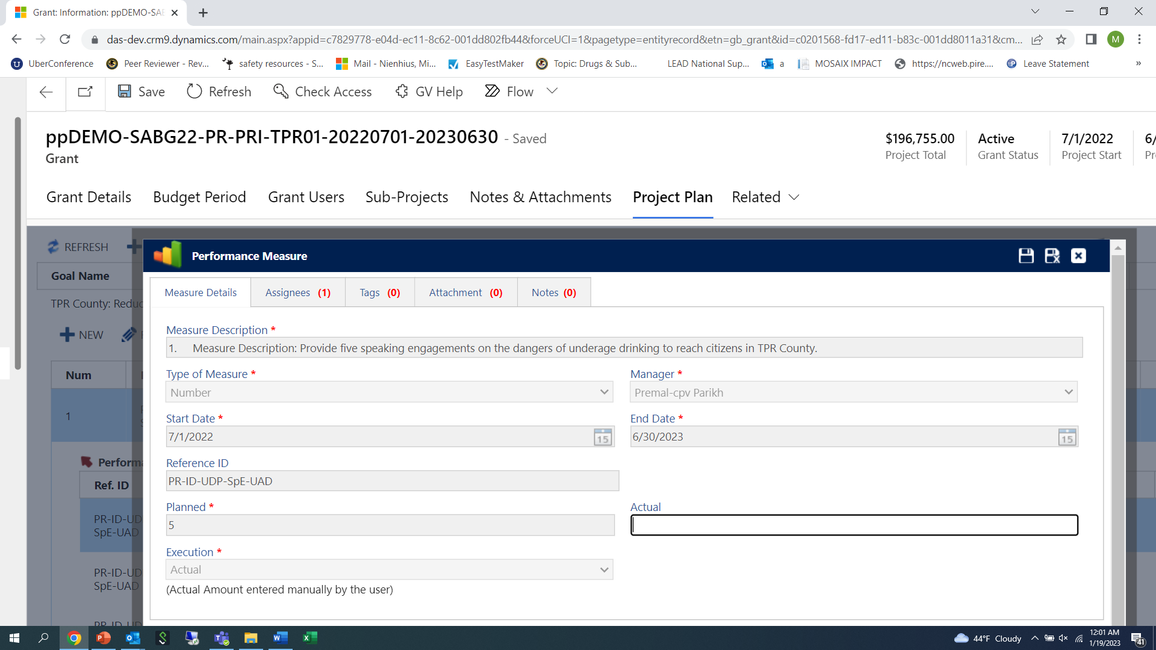
Add number under “actual” Single click on the “disk” icon with the “x” at the top to save and close the form

Slide 14
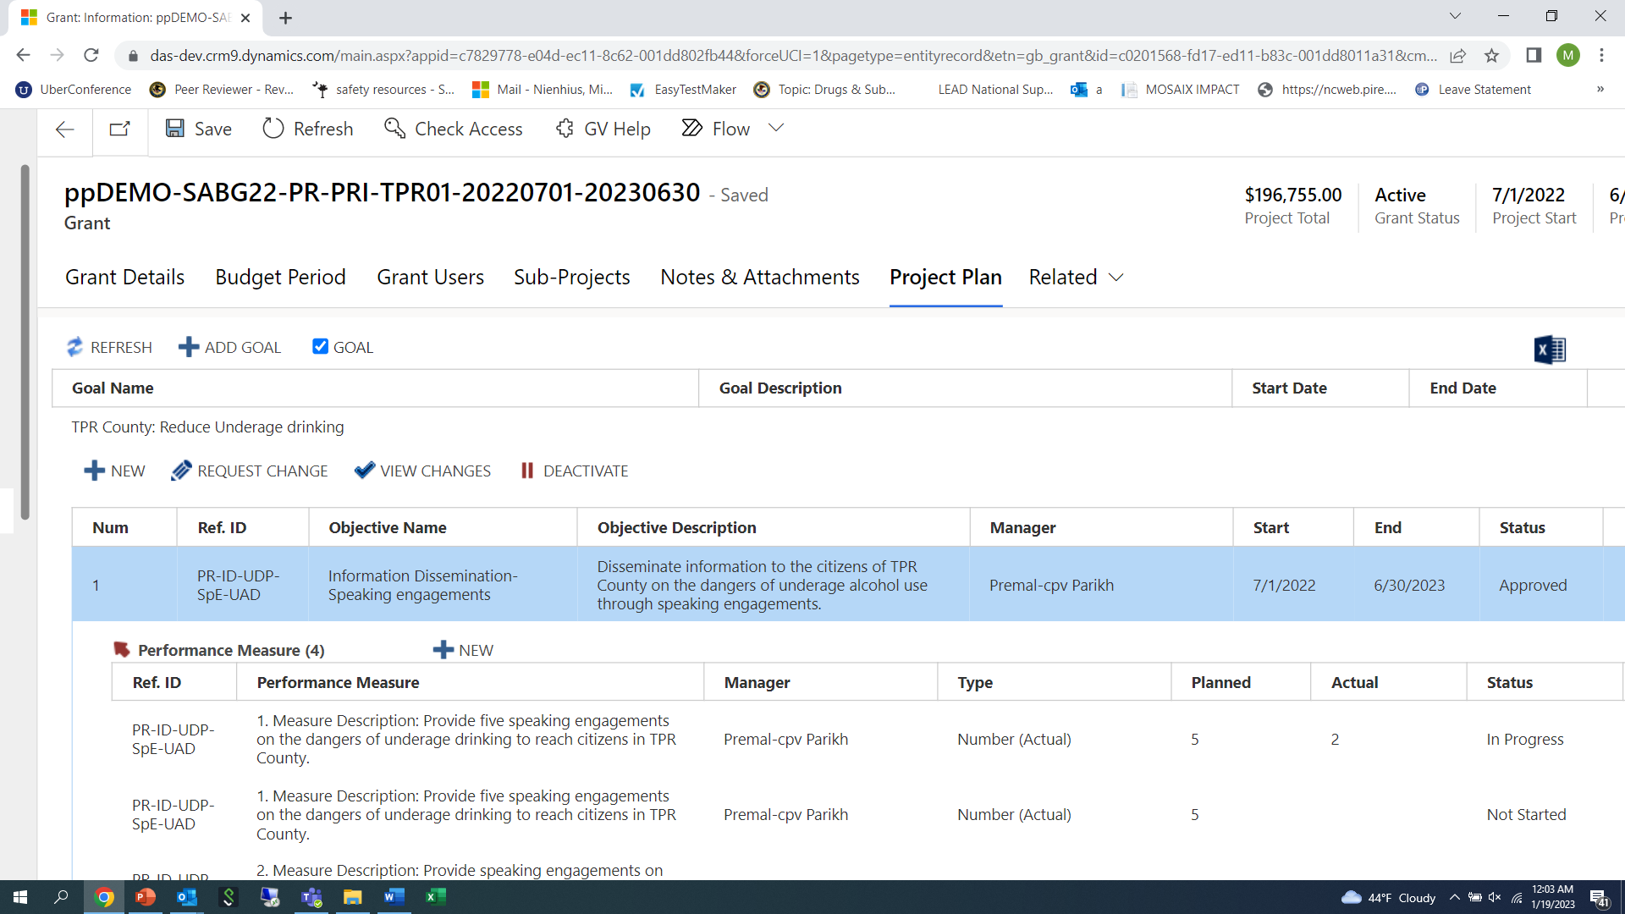
After the form saves, it will take you back to the screen below and you should see the number you entered displayed under the “actual” column.

